Slide 1
AlgoCart CTO home assignment – Mordechi Mor sofer
The problem: Titanic - Machine Learning from Disaster, the goal is to predict if someone would survive the titanic crash disaster by using the Kaggle database of the titanic.
My approach: after looking at the data and analyze the database a little I decided to make two solutions:
1. the first one is based on different classifiers from sklearn library such as knn, linear regression, decision trees, etc.
2. the second one is using a neural network with keras and TensorFlow, in my personal opinion it’s not good always to run for NN because it’s can take a long time to run and a lot of computing power, but in this case, we work with simple data, therefore, it’s didn’t took to much time

Slide 2
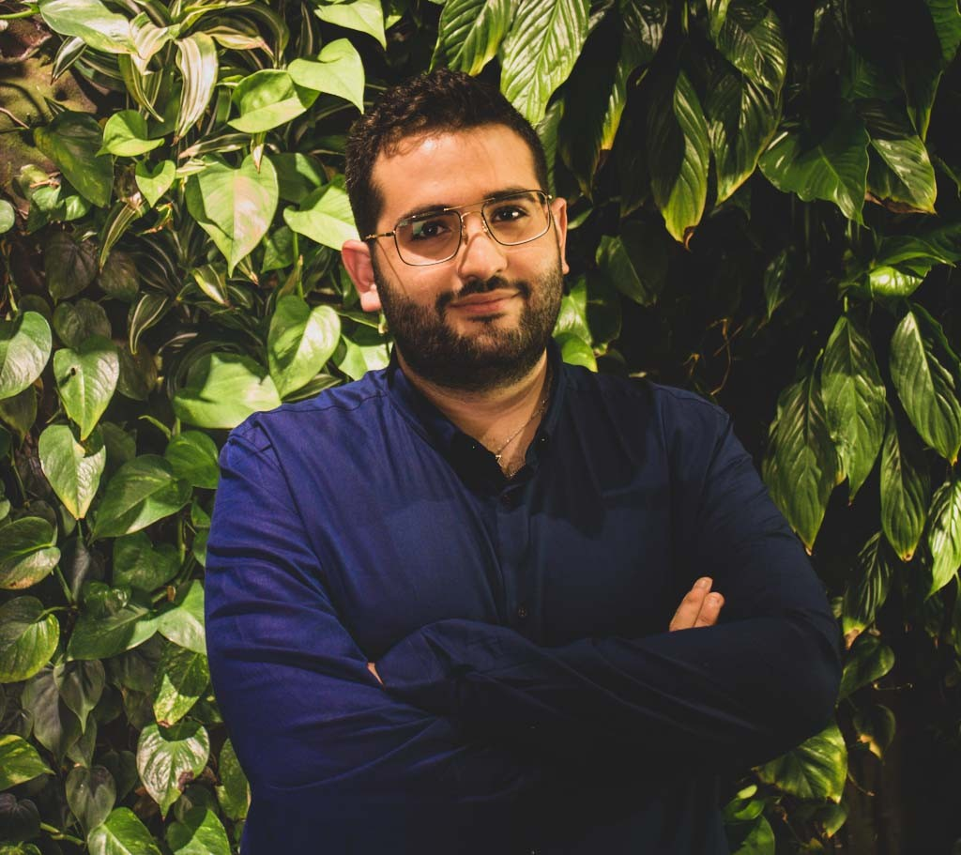
About
Work hard, Question everything, and come up with creative solutions.
I am Mor an Algorithms R&D Software Engineer experienced with Computer Vision, ML and Algorithm development. The paper that I published worldwide helps companies to save billions of dollars and massive amount of time. Motivated for my next challenge in a company that is looking for a team player and quick learner to develop efficient solution to complex problem.
MS.c Computer Science in the Open University of Israel, close to end my degree with research in VR, NN and ML.
I developed Font Recognition engine based on NN with Keras, Tensorflow and CV2 got to 94% accuracy
Done research, which was published worldwide at the FEDSM, Florida conference.
BS.c Software Engineer gradate from Jerusalem College of Technology Lev
Team Leader in IDF

Slide 3
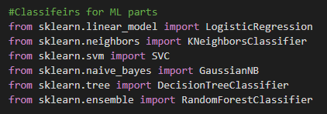

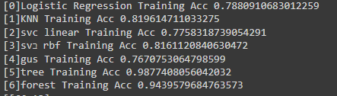

First solution, classifiers
I started by analyze the database and check for problematic values, for example, missing values and of course duplicates or unnecessary (like cabin numbers). When we talk about a disaster like the titanic the location of the cabin can tell us a lot but the number is less important. After I did all the analysis and feature selecting I used sklearn library to import few different classifiers for this dataset, I used commons ones and choose the best result
From the Confusion matrix of the result it’s was simple to extract the score of each one of those classifiers:

Slide 4

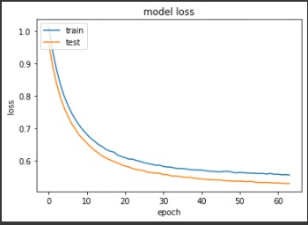
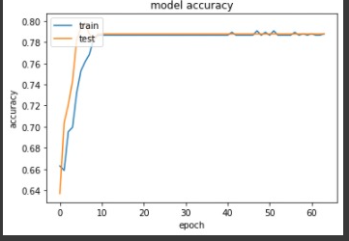
Second solution, Keras NN
The downside using NN:
There is not enough data – but when I check other models around the web even by geniting more data the result didn’t have any significant effect.
Easy to get overfit
Taking more time than the classifier and got a similar result.
But still even when the result was similar the difference between the testing and the training accuracy wasn’t very big as we can see both of them tends towards 80%.
The model is simple model of 3 layers:
model = Sequential()
model.add(Dense(32,input_shape=(X_train.shape[1],),kernel_regularizer='l2'))
model.add(Activation("relu"))
model.add(Dense(32, kernel_regularizer='l2'))
model.add(Activation("relu"))
model.add(Dense(16,kernel_regularizer='l2'))
model.add(Activation("relu"))
model.add(Dense(1,kernel_regularizer='l2'))
model.add(Activation("sigmoid"))
model.compile(loss='binary_crossentropy',optimizer ="Adam", metrics=['accuracy'])

Slide 5
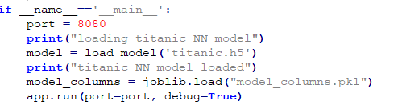
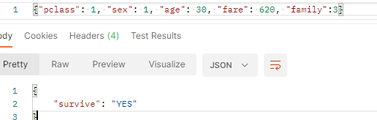
The Api
I build the API with Flask and use postman desktop to check it, after few minutes I got the API running on localhost:8080 (127.0.0.1:8080/predict)While the host was running I sent a “POST” request from the postman desktop:
Features explanation:
Pclass – the class the passenger was (first, second or third)
Sex – 1 indicate male, 0 indicate female (auto-generate by labelencoder)
Age – the passenger age
Fare – the passenger fare
Family – how many family members are on the board with him.
I used this value instead of SibSp and Parch because
when we removed them the result gets very low, therefore instead of
getting two duplicate values about family members I combined them.

